Slide 1

DriverPass System Analysis
Elijah Stapleton
Notes:
[No speaker notes required for this slide.]

Slide 2

System Requirements
Functional Requirements
The system shall authenticate password when logging in (password is case sensitive email/ username is not).
The system shall send a short message code to user via SMS when logging in if 2 factor authentication is turned on by user.
Non-Functional Requirements
The web application will need internet connectivity to function.
The web application will need storage for the website and database.
Notes:
DriverPass has many requirements both functional and non-functional for the system to run properly. Functional requirements explain how the system for DriverPass must work, and non-functional requirements explain how the system should preform. An example of a functional requirements would be the ability for users to register their accounts and log themselves in. Users must enter a valid user-name and password to log into and use the system. Another example of a functional requirements is the need for an API to access and store DMV documents and data on our site for users to see.
An example of a non-functional requirements would be for the website to have access to data storage for the database to store user account information or for users to be able to reset their password using text or email verification to send them a reset link.

Slide 3
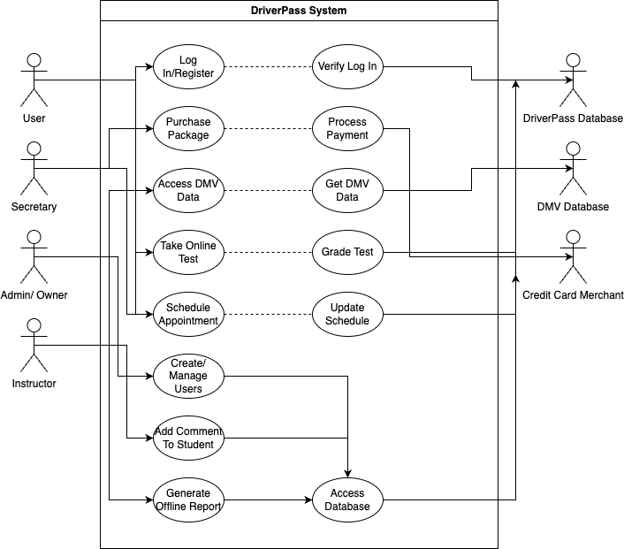
Use Case Diagram
Notes:
The diagram above shoves various users and their roles and uses for the DriverPass system. Certain users can access, and complete different actions based on their user permissions. Base users can log in and register their accounts and this is verified using a database with user account information. Users can purchase packages, take tests, schedule appointments, and view appointments. A secretary or employee can do everything a user can except take tests for users. An instructor can only add notes to a user's profile. An Admin can create and manage users, change the database, and generate offline reports for later use. The diagram was created to meet DriverPass’s needs for the system and the use case for each user that will access and use the system. As Driver Pass's system grows/ expands more use cases can be added or modified to fit the growing business needs.

Slide 4
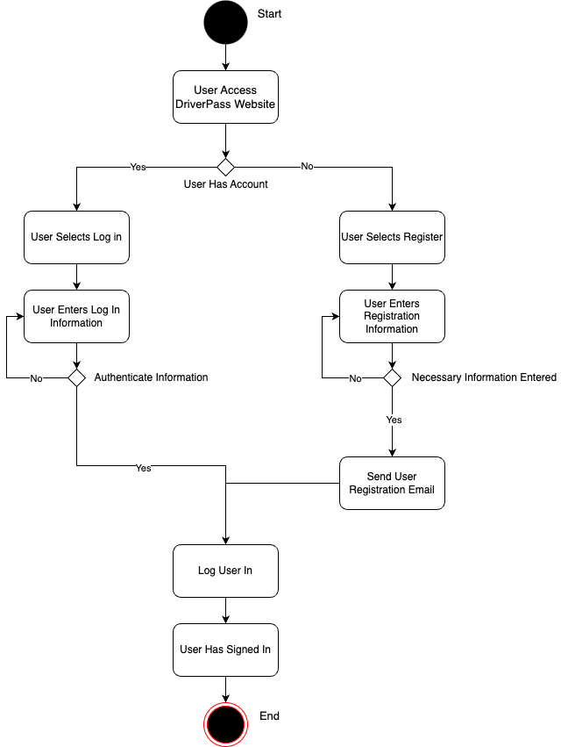
Activity Diagram
Notes:
The diagram above explains the activity of logging in, in detail. A user accesses the DriverPass website and either logs in if they have created an account previously or registers if they have never used the DriverPass system before. Both registering and logging in require input validation to verify if the user entered information is correct or not. If a user is registering and they do not enter the required information and error will be generated, and they must enter the correct information to continue. If a user enters the incorrect log in information, it will ask for the user information again and will not let them access the system until the correct information is entered. After a user has entered the correct information to register, they are sent a conformation email and then logged into the DriverPass system. After a user enters the correct log in information they are allowed into the system and greeted to their user portal.
DriverPass requires a simple way for users to log into their user account and they require security so that user information is not stolen from bad actors, this is the reason behind user authentication to grant access to the site.

Slide 5
Security
User is required to authenticate log in using email, password, and optional 2 factor authentication using SMS.
To gain access to system users must enter password.
2 factor authorization stops bad actors from brute forcing their way into system.
HTTPS, AES-256, and Certificates are all security measures taken to make sure unauthorized access is not granted to bad actors.
Notes:
Security is a top priority when holding sensitive data. 2 Factor authentication using SMS text messaging is a great way to make sure that only the intended user is allowed into the system. Using HTTPS is a protocol that uses a secure communication channel between the driver pass system and the user of the system. AES and certificate encryption allow any data sent between the user and system to be encrypted to stop bad actors from viewing it. Requiring a password to authenticate a user is the first step in making sure unintended access is not granted to the system, this also stops brute force attacks into the system as well.

Slide 6
System Limitations
Some client devices may not be able to access the website due to geographic limitations, or web browser limitations
An outage at a data center cannot be anticipated and will cause system to not be able to be accessed
Notes:
DriverPass wishes to use a third-party cloud service to host the website, in other words a third party will house all data of the system and is associated components. While third party hosting is great if the third-party experiences say a power outage access to the DriverPass system will be lost until the third-party fixes the issue. Another limitation that cannot be helped is that some users will have outdated or incompatible browsers, while this is rare it is a possibility, and this cannot be accounted for.

